Slide 1
Compiler Construction
Mukesh Kumar Tripathi
Assistant Professor
Department of Information Technology
Vasavi College of Engineering

Slide 2
Why Compilers?
Computers only understand machine language
Machine language consists of binary digits or bits, which come in the form of zeros and ones.
The programmers write programs in a high-level programming language
Before a program can be run, it first must be translated into a form in which it can be executed by a computer.
The software systems that do this translation are called compilers.

Slide 3
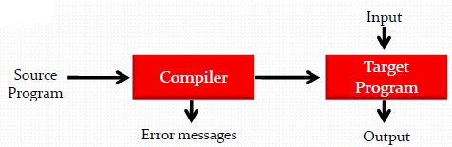
Compilers
A compiler is a program that takes a program written in a source language and translates it into an equivalent program in a target language.
The translation process should also report the presence of errors in the source program.
If the target program is an assembly language program then an assembler is used to convert it into machine language.
If the target program is an executable machine-language program, it can then be called by the user to process inputs and produce outputs.

Slide 4
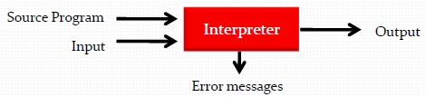
Programs related to Compiler
Interpreters
Execute the source program immediately rather than generating object code
Many languages have been implemented using both compilers and interpreters, including Lisp, Pascal, BASIC, and Python.
Speed of execution is slower than compiled code by a factor of 5 or more
An interpreter, however, can usually give better error diagnostics than a compiler, because it executes the source program statement by statement

Slide 5
Assemblers
A translator for the assembly language of a particular computer
Assembly language is a symbolic form of one machine language
A compiler may generate assembly language as its target language and an assembler finished the translation into object code
Preprocessors
Separate program that is called by the compiler before actual translation begins.
Preprocessors produce input to compilers.
They may perform the functions like Macro processing, File inclusion, etc.

Slide 6
Linkers
Both compilers and assemblers often rely on a program called linker
Collects code separately compiled and assembled in different object files into a file that is directly executable.
A linker also connects an object program to the code for standard library functions and to resources supplied by the operating system of the computer, such as memory allocators and input-output devices.
Loaders
Resolve all re-locatable address relative to a given base
Make executable code more flexible
Often as part of the operating environment, rarely as an actual separate program

Slide 7
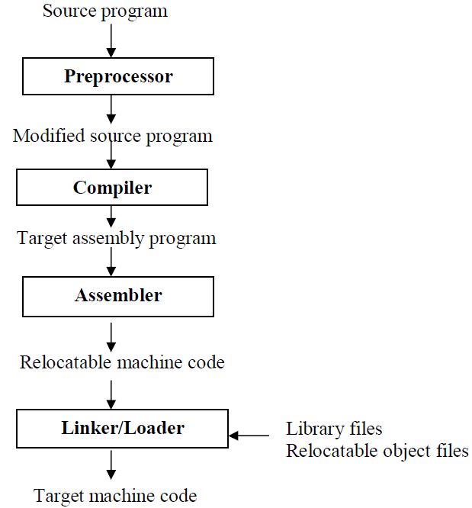
A Language Processing System

Slide 8
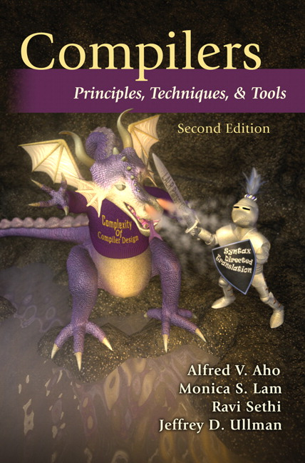
Compiler Construction : Textbook
Alfred V. Aho, Monica S. Lam, Ravi Sethi, and
Jeffrey D. Ullman,
“Compilers: Principles, Techniques, and Tools”
Second Edition.

Slide 9
Compiler Construction
Objective: To introduce the major concept areas of language translation, and to enrich the knowledge in various phases of compiler and its use.
After the course
Know how to use compiler construction tools, such as generators for scanners and parsers
Design top-down and bottom-up parsers.
Be familiar with compiler analysis and optimization techniques

